Slide 1
SQL Queries – Workbook 1
On each of the slides there will be a question. Using the movies dataset, write any appropriate query to search for the data that will answer the question. Screenshot the query and result onto the relevant slide.

Slide 2
PART 1
QUERIES WITHOUT AGGREGATE FUNCTIONS

Slide 3
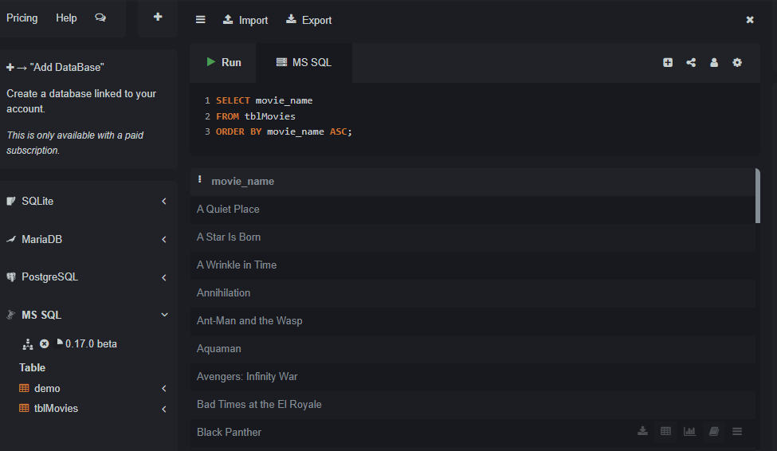
Retrieve the names of all movies in the dataset.

Slide 4
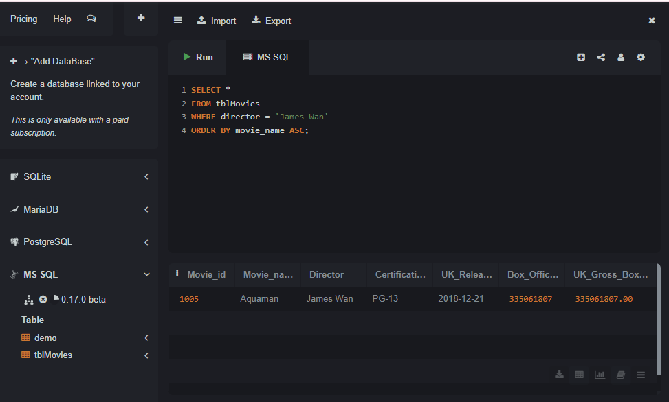
Retrieve the details of all movies directed by ‘James Wan’

Slide 5
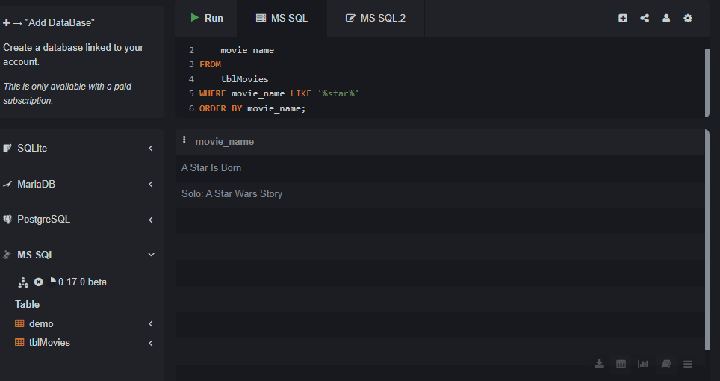
List the movie names and certifications for movies released in 2018.

Slide 6
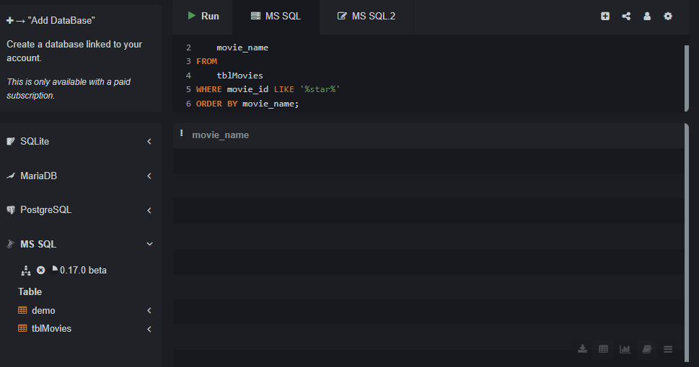
Find the names of movies with 'star' in their title.

Slide 7
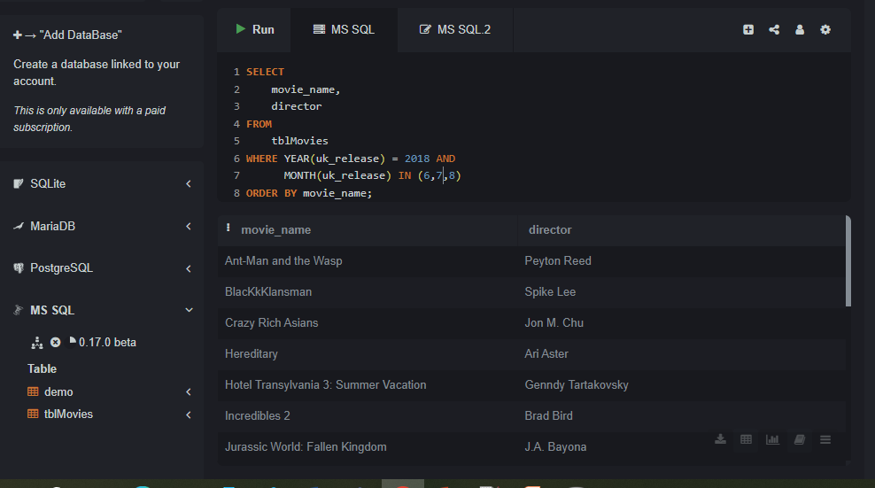
Get the movie names and directors for movies released in the summer months (June, July, August) of 2018.

Slide 8
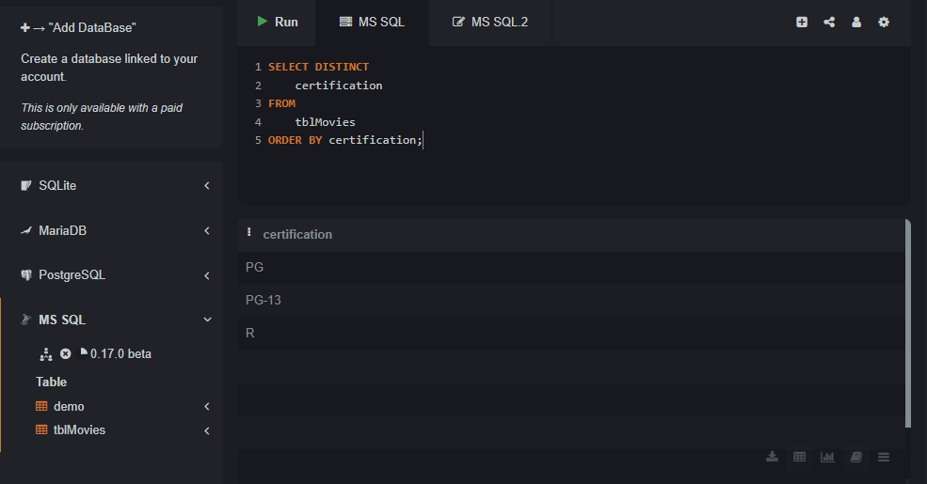
List the certifications and their unique values in the dataset.

Slide 9
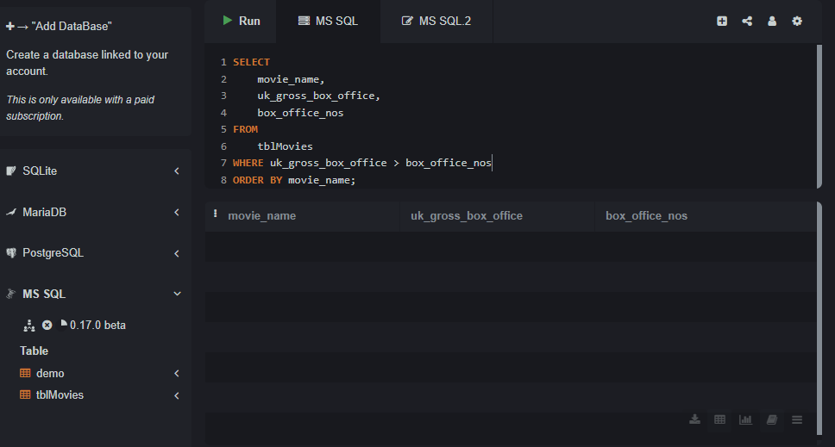
Retrieve the names of movies with a UK gross box office value greater than their box office numbers.

Slide 10
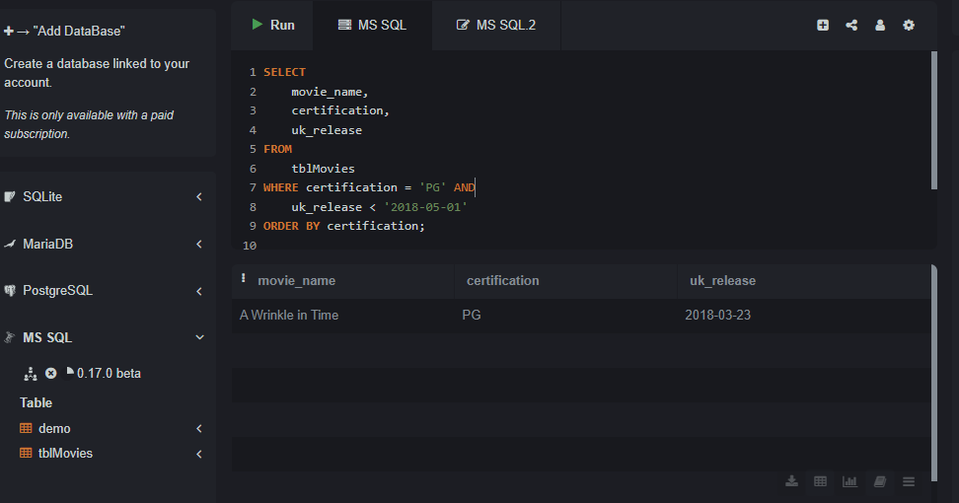
Find the movies with a certification of 'PG' and a UK release date before 2018-05-01.

Slide 11
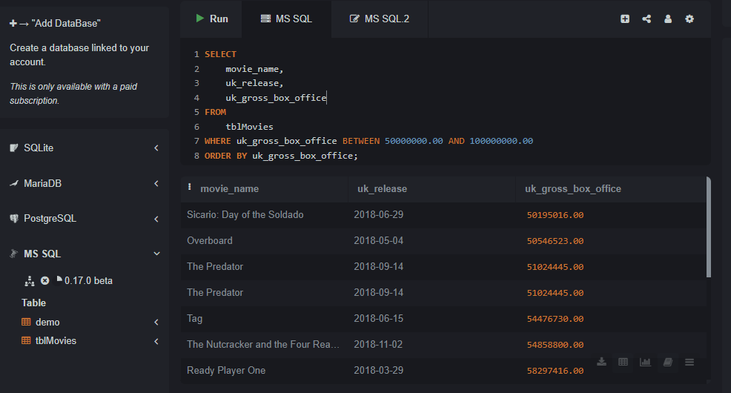
Get the movie names and UK release dates for movies that earned between 50 million and 100 million at the UK box office.

Slide 12
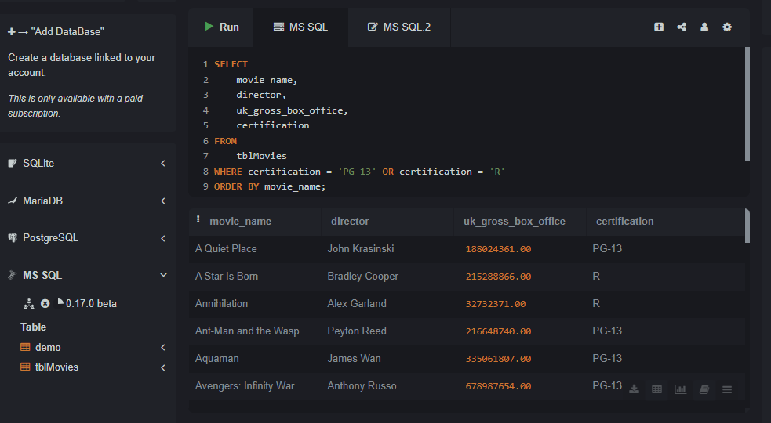
List the movie names, directors, and UK gross box office values for movies with certifications of 'PG-13' and 'R.'

Slide 13
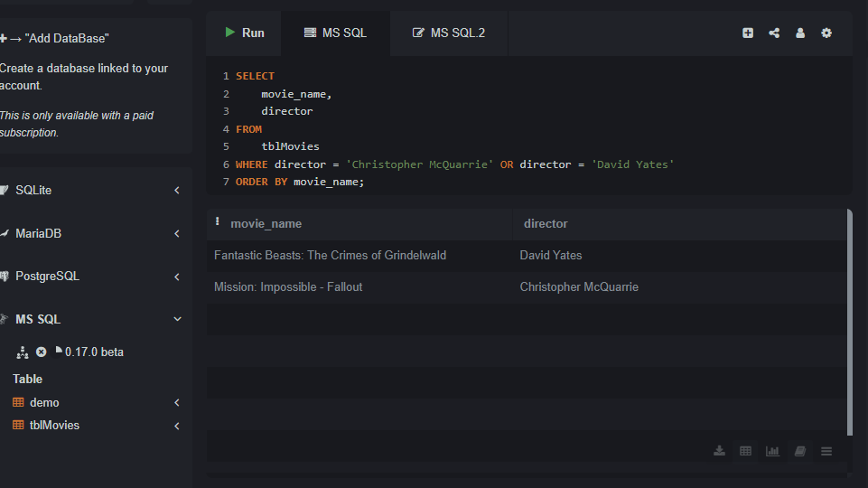
Find the movies directed by 'Christopher McQuarrie' or 'David Yates.'

Slide 14
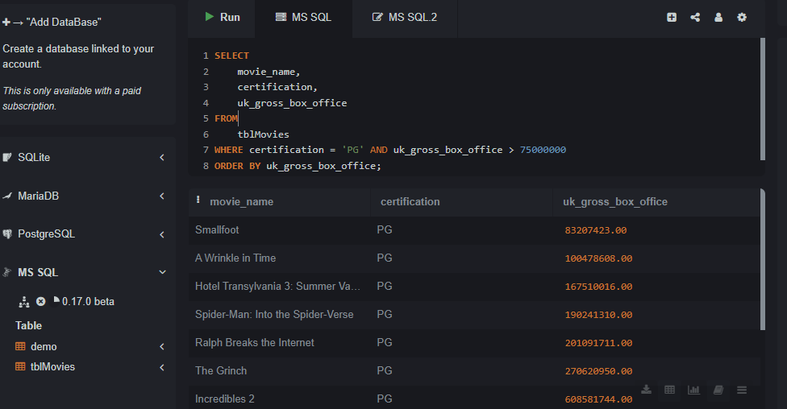
List the movies with a certification of 'PG' and a UK gross box office value greater than 75 million.

Slide 15
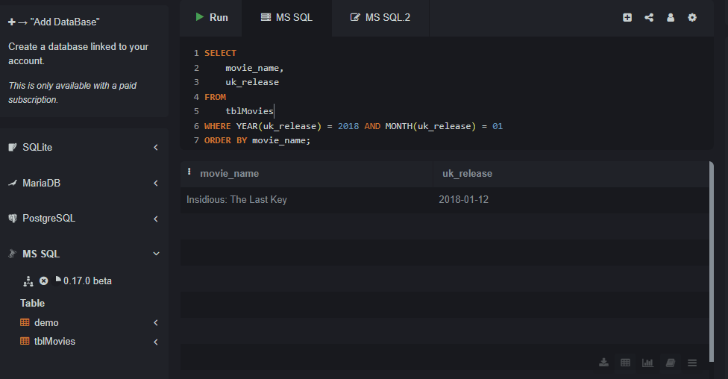
Find the movies released in January 2018.

Slide 16
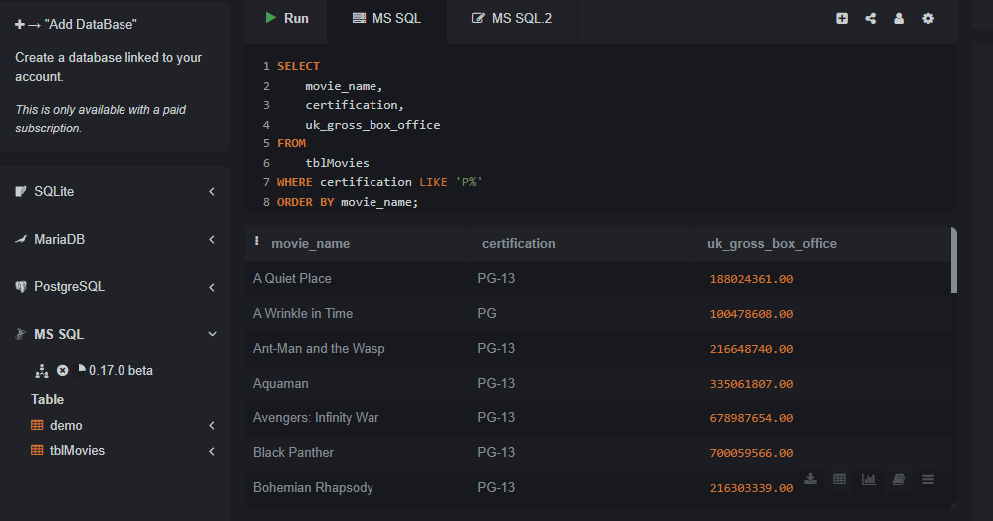
Retrieve the certifications and their associated UK gross box office values for movies with a certification that starts with 'P.'

Slide 17
PART 2
QUERIES WITH AGGREGATE FUNCTIONS and NESTED queries

Slide 18
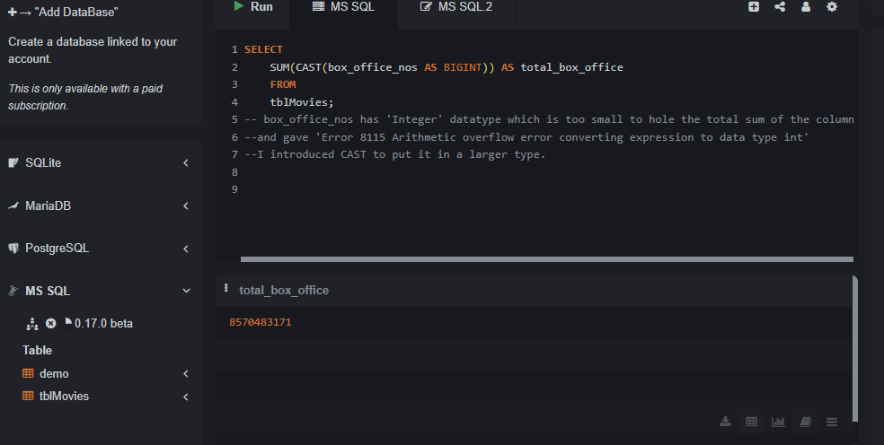
Calculate the total box office numbers for all movies.

Slide 19
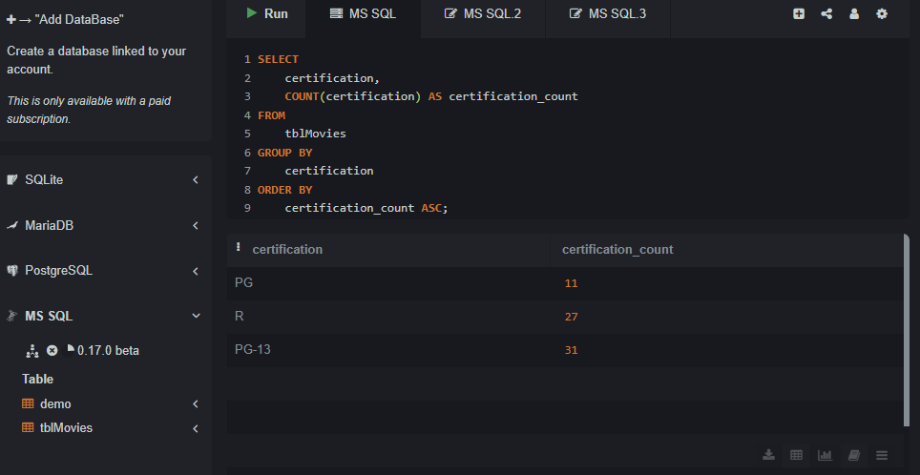
Retrieve the certifications and their counts in the dataset.

Slide 20
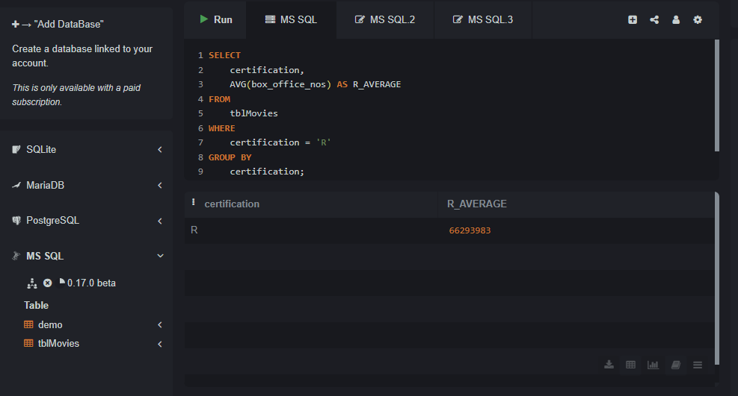
Get the average box office numbers for 'R'-rated movies.

Slide 21
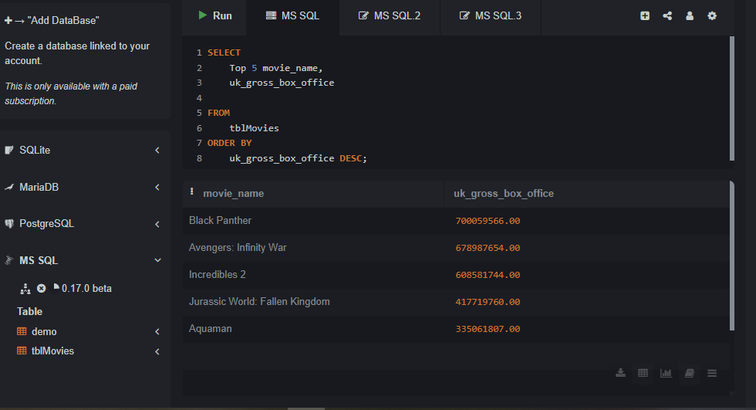
Find the top 5 movies with the highest UK gross box office.

Slide 22
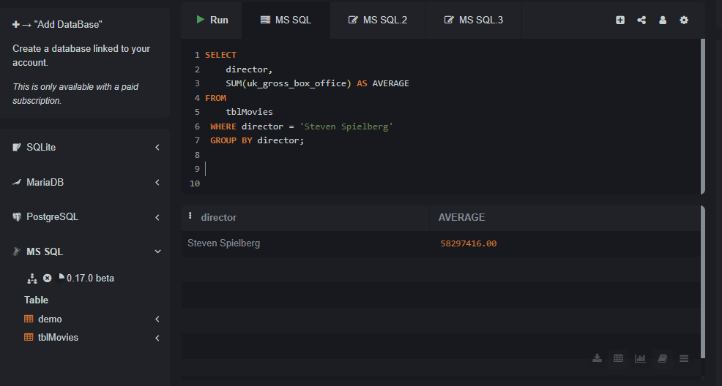
Get the total UK gross box office for movies directed by Steven Spielberg.

Slide 23
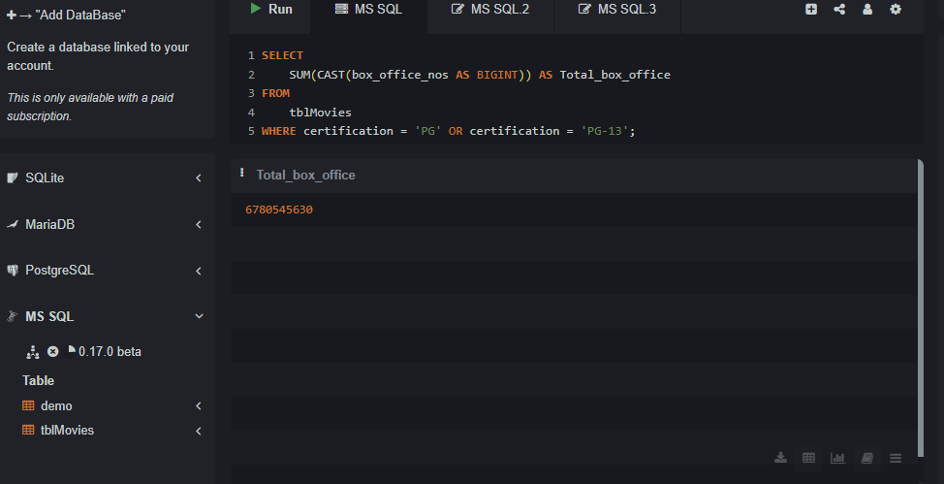
Calculate the total box office numbers for movies with certifications 'PG' or 'PG-13.'

Slide 24
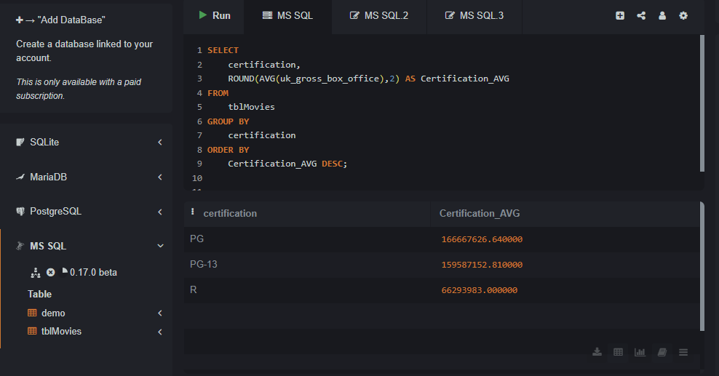
Get the certifications and their average UK gross box office values.

Slide 25
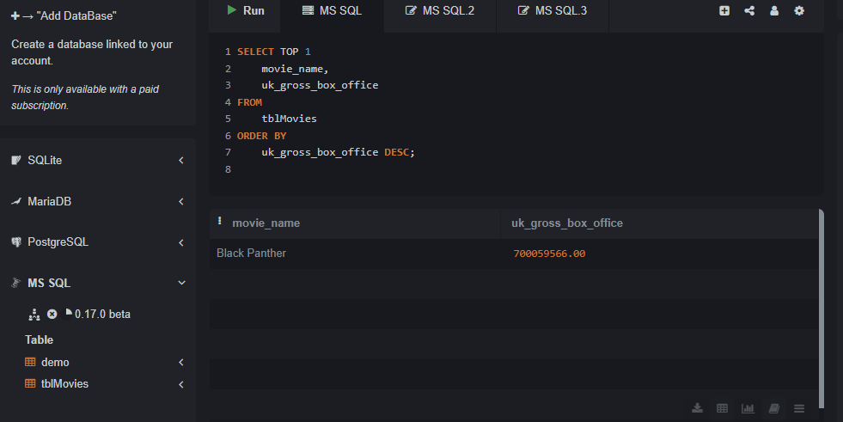
Find the movie with the highest UK gross box office.

Slide 26
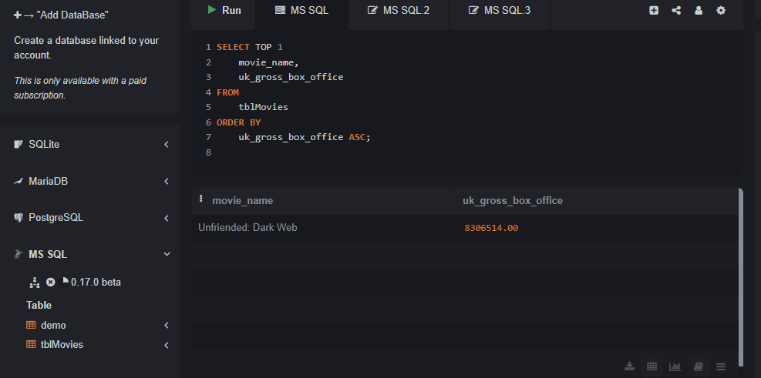
Find the movie with the lowest UK gross box office

